Slide 1
PCB Doctor AI
AI-Based Hand-Drawn Circuit Diagram Analysis and Schematic Generation
Team ID: H26EDU02
Team Lead: GURU PRASATH J
Team name: COCKROACH
Team Members:
College Name:
GURU PRASATH J
HARI PRIYA J
CHARANRAJ I
K. Ramakrishnan College of Engineering

Slide 2
Problem Statement & Objectives
Problem Statement
Students and engineers often draw circuit diagrams on paper. Converting these hand-drawn circuits into digital schematics is a manual, time-consuming, and error-prone process. Existing software mainly supports digitally created circuits and does not effectively recognize hand-drawn symbols.
Objectives
Detect electronic components from hand-drawn circuit diagrams.
Identify components using a YOLO11 AI model.
Display detected components with labels.
Build a user-friendly web application.
Lay the foundation for automatic schematic generation.

Slide 3
Existing Solutions & Identified Gaps
Existing Solution | Limitation
OCR-based recognition | Poor performance on hand-drawn symbols
CAD tools (Proteus, KiCad) | Require manual circuit drawing
Generic object detection | Not trained for circuit symbols
Traditional image processing | Low accuracy for complex sketches
Identified Gap
No simple AI system accurately detects hand-drawn electronic symbols and assists in converting them into digital schematics.

Slide 4
System Design(BLOCK DIAGRAM)
Hand-Drawn Circuit
Image Upload
Image Preprocessing
Component Counting
Component Recognition
YOLO11 Detection
Technologies Used
Python
YOLO11
Roboflow
OpenCV
Streamlit or HTML
Digital Schematic
OUTPUT

Slide 5
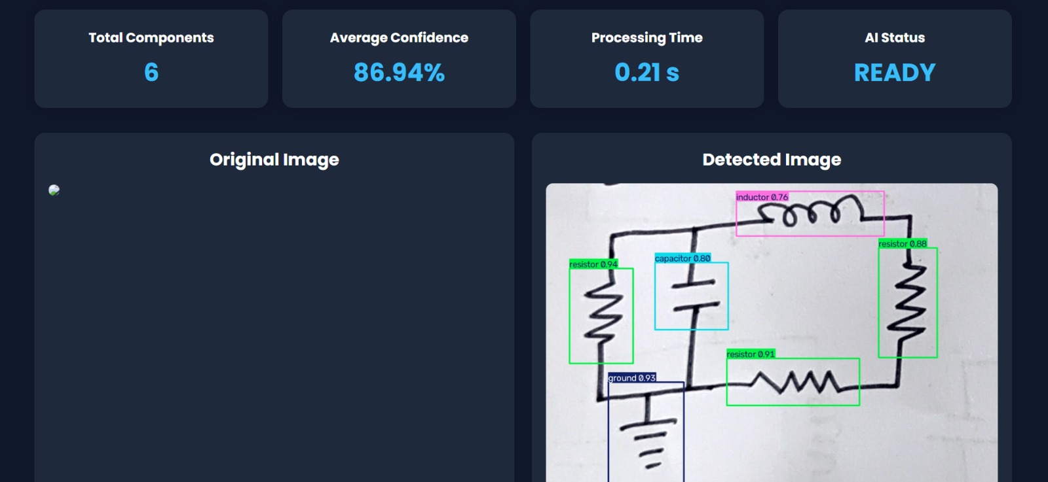
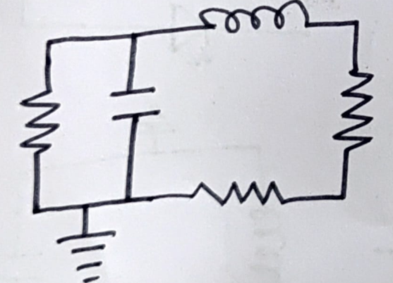
Implementation Progress
Current Development
Problem analysis completed
Dataset created and annotated (162 images)
YOLO11 model trained
Streamlit web application developed
Component detection successfully tested
Work in Progress
Automatic schematic generation
Circuit connection analysis
Improving model accuracy

